Slide 1
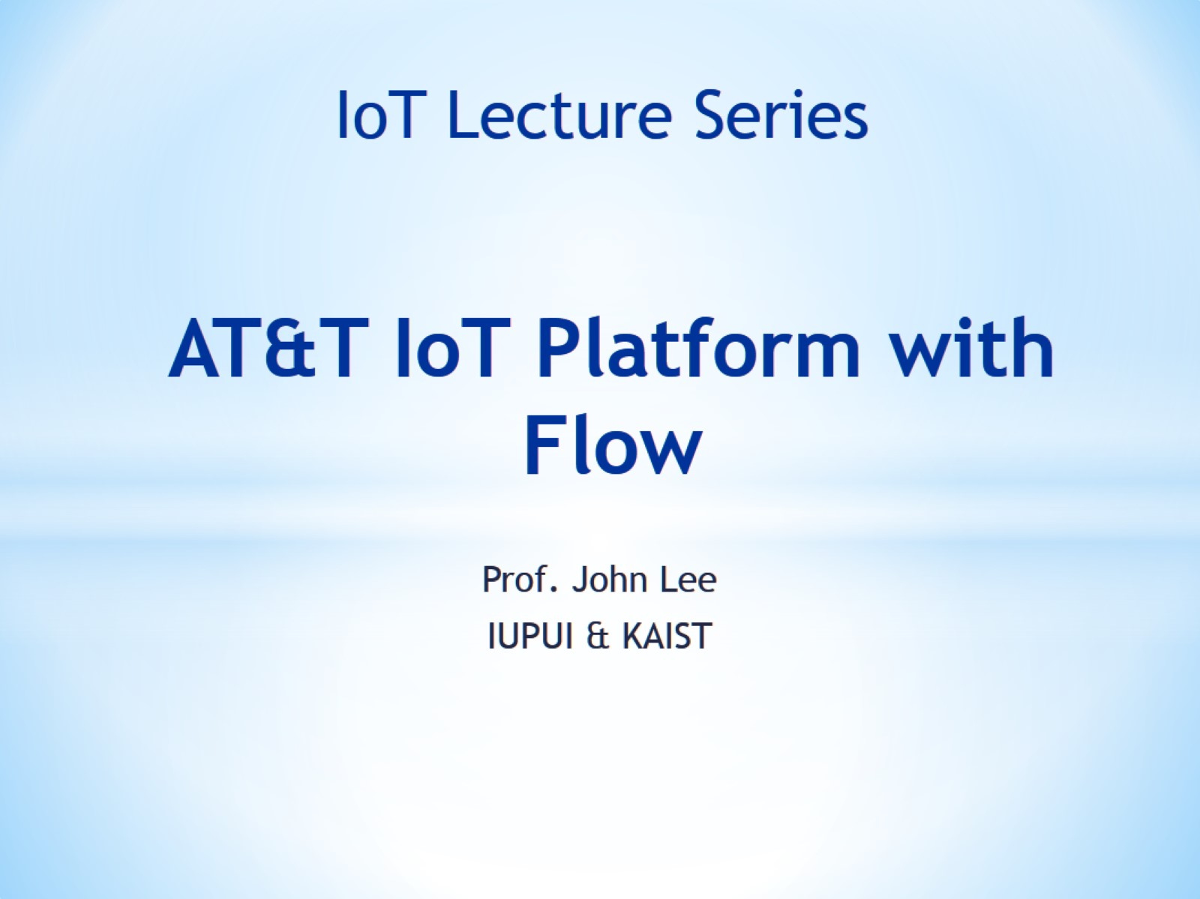
AT&T IoT Platform with Flow

Slide 2
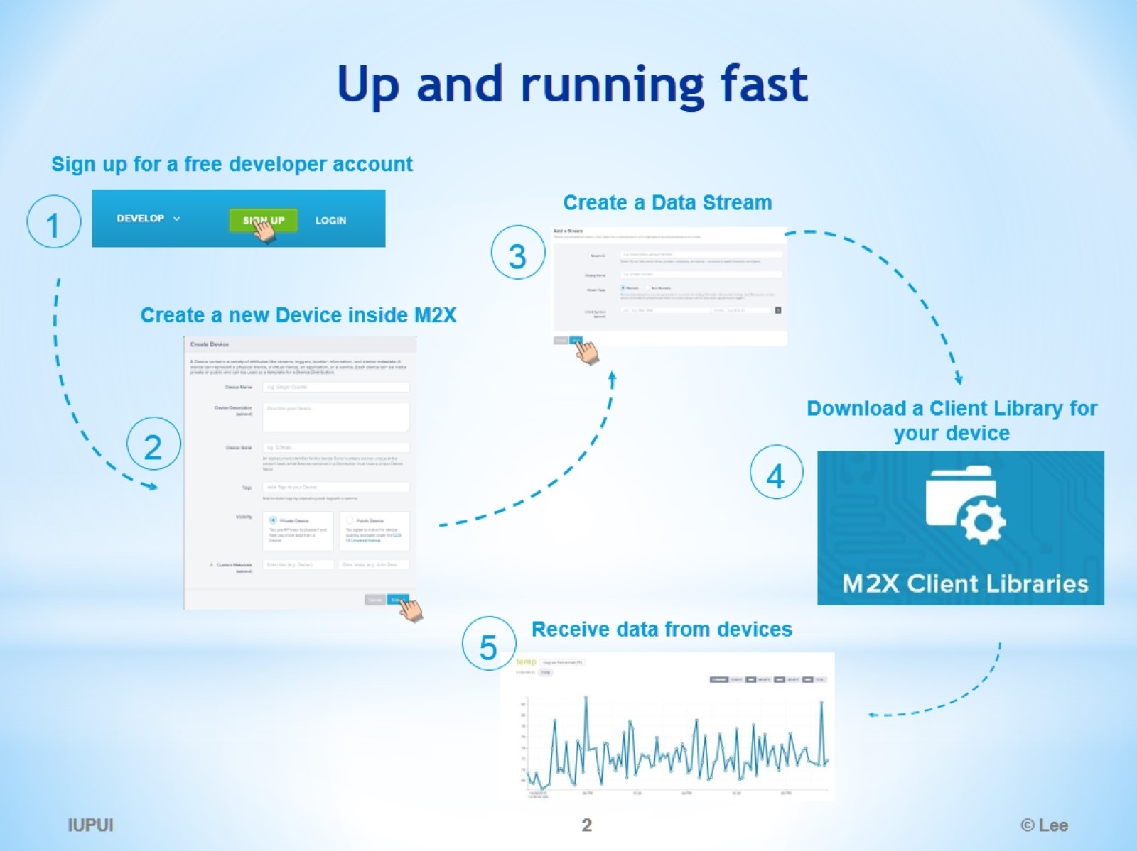
Up and running fast

Slide 3
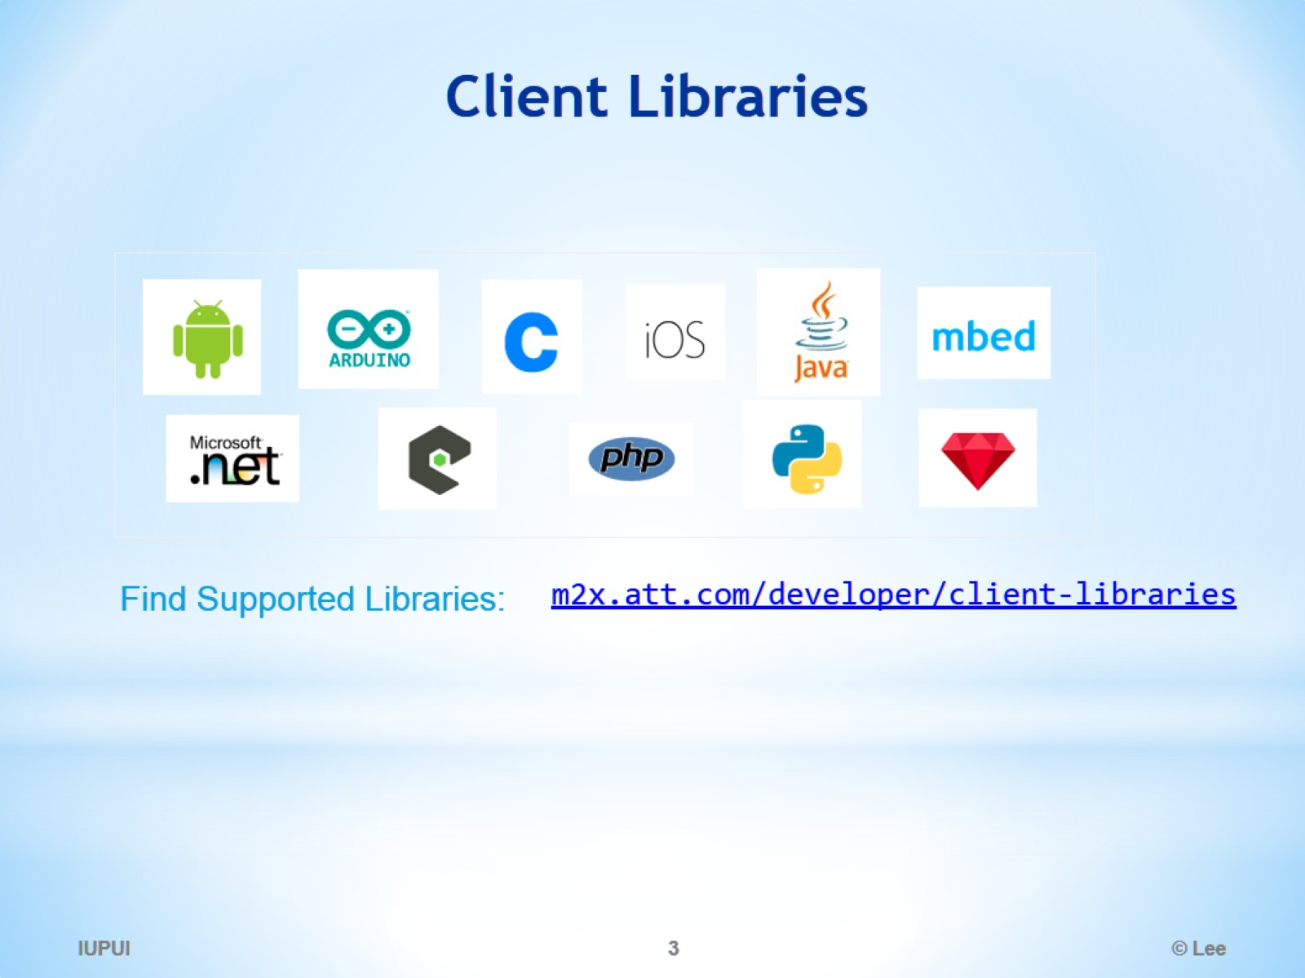
Client Libraries

Slide 4
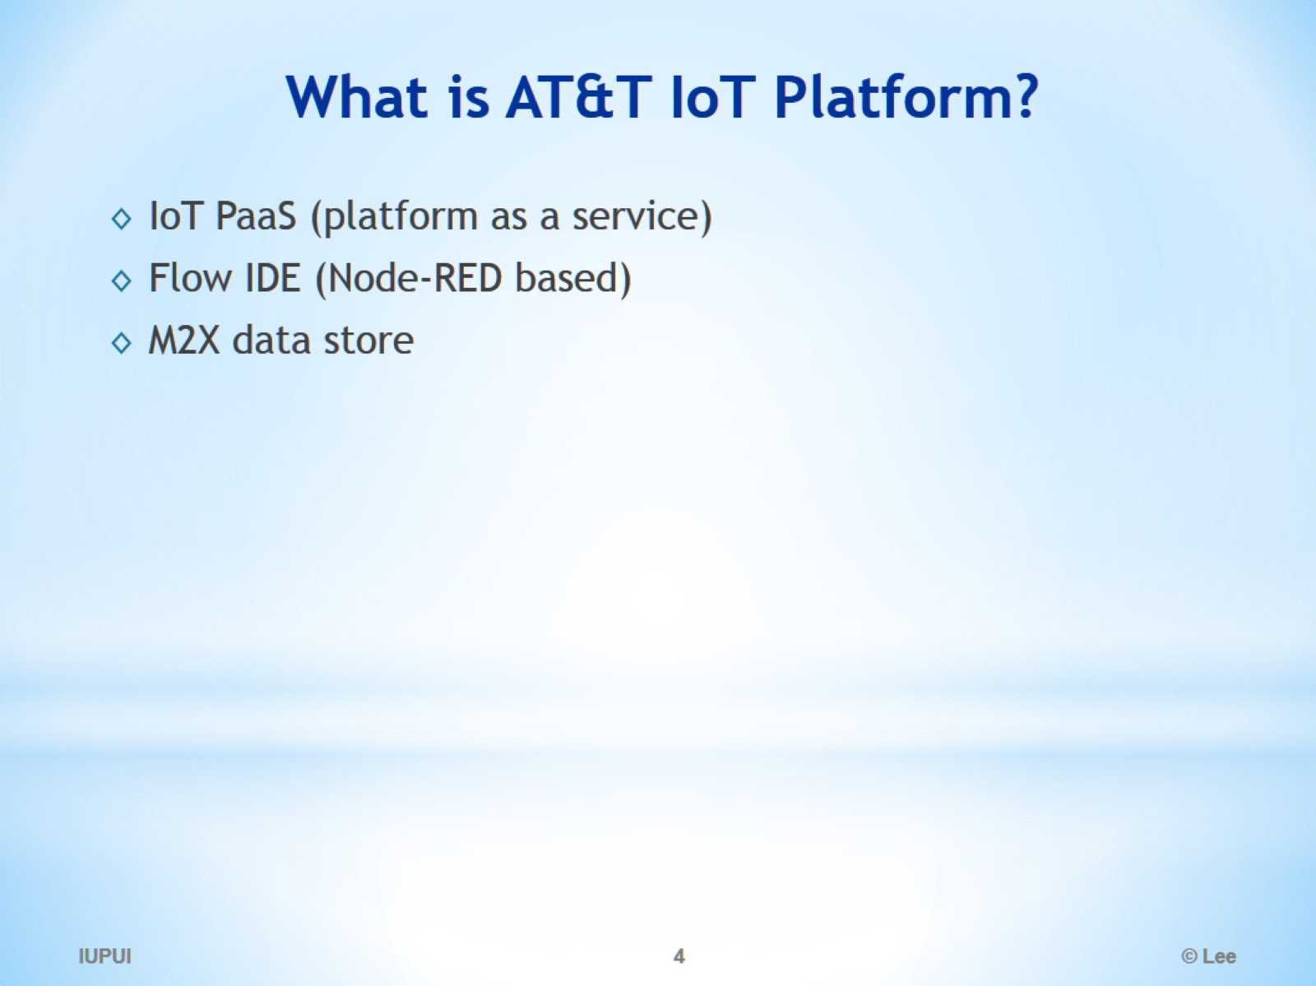
What is AT&T IoT Platform?

Slide 5
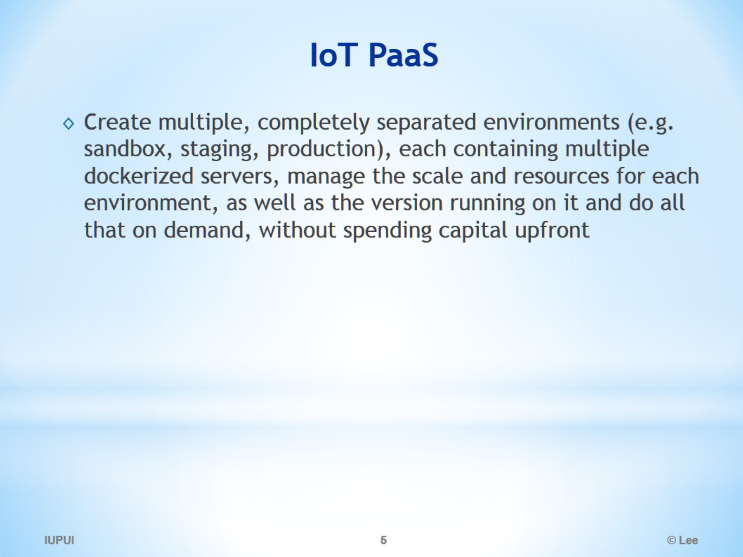
IoT PaaS

Slide 6
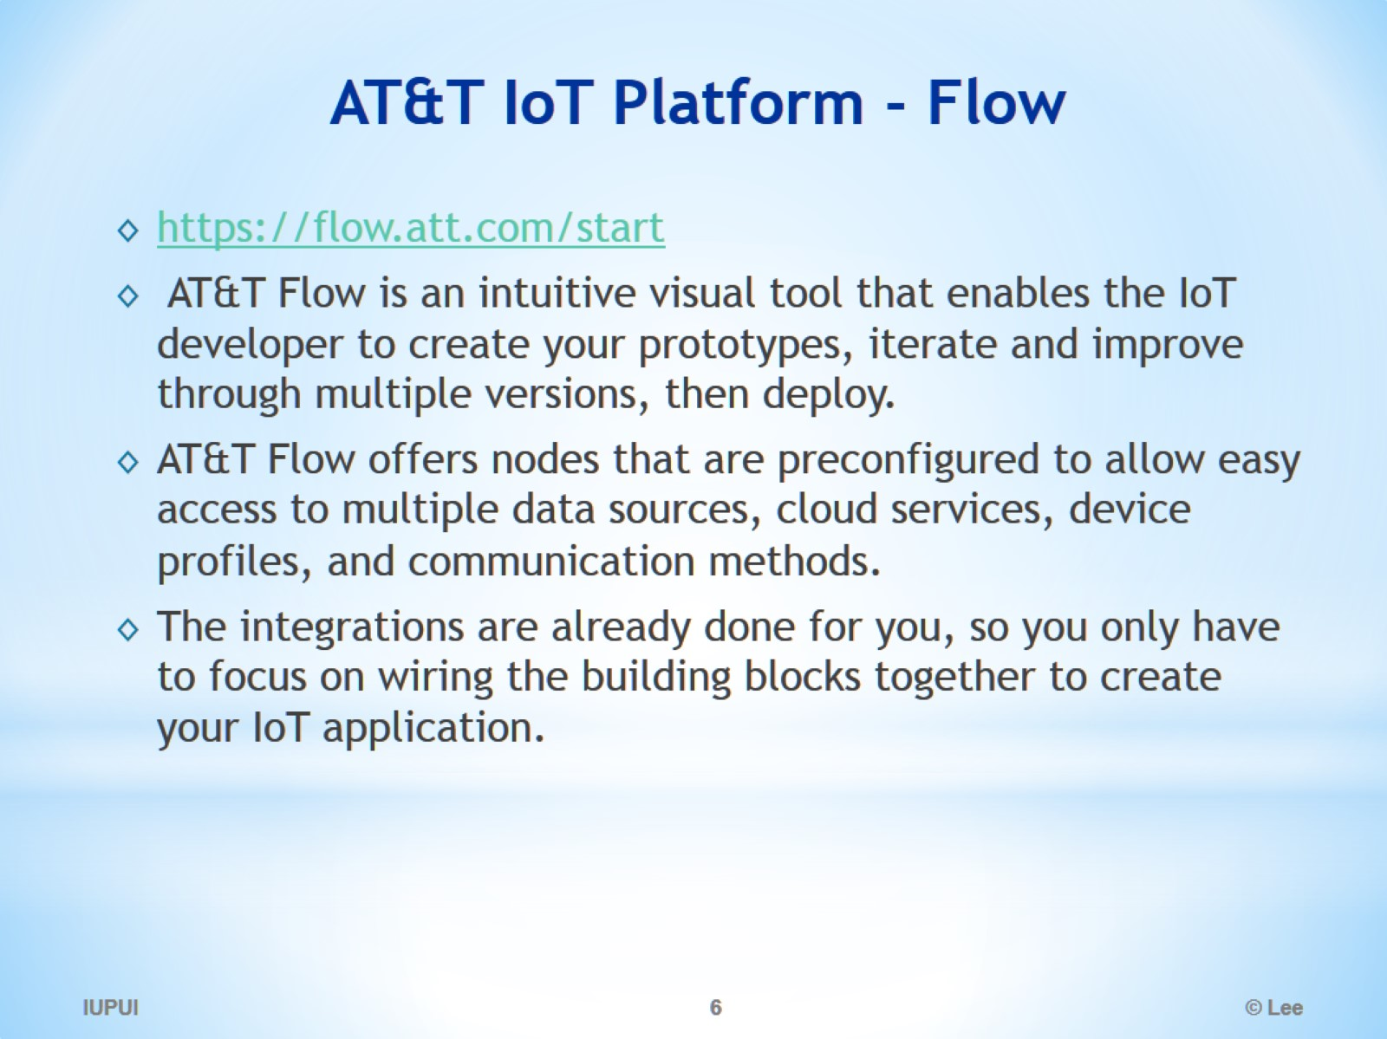
AT&T IoT Platform - Flow

Slide 7
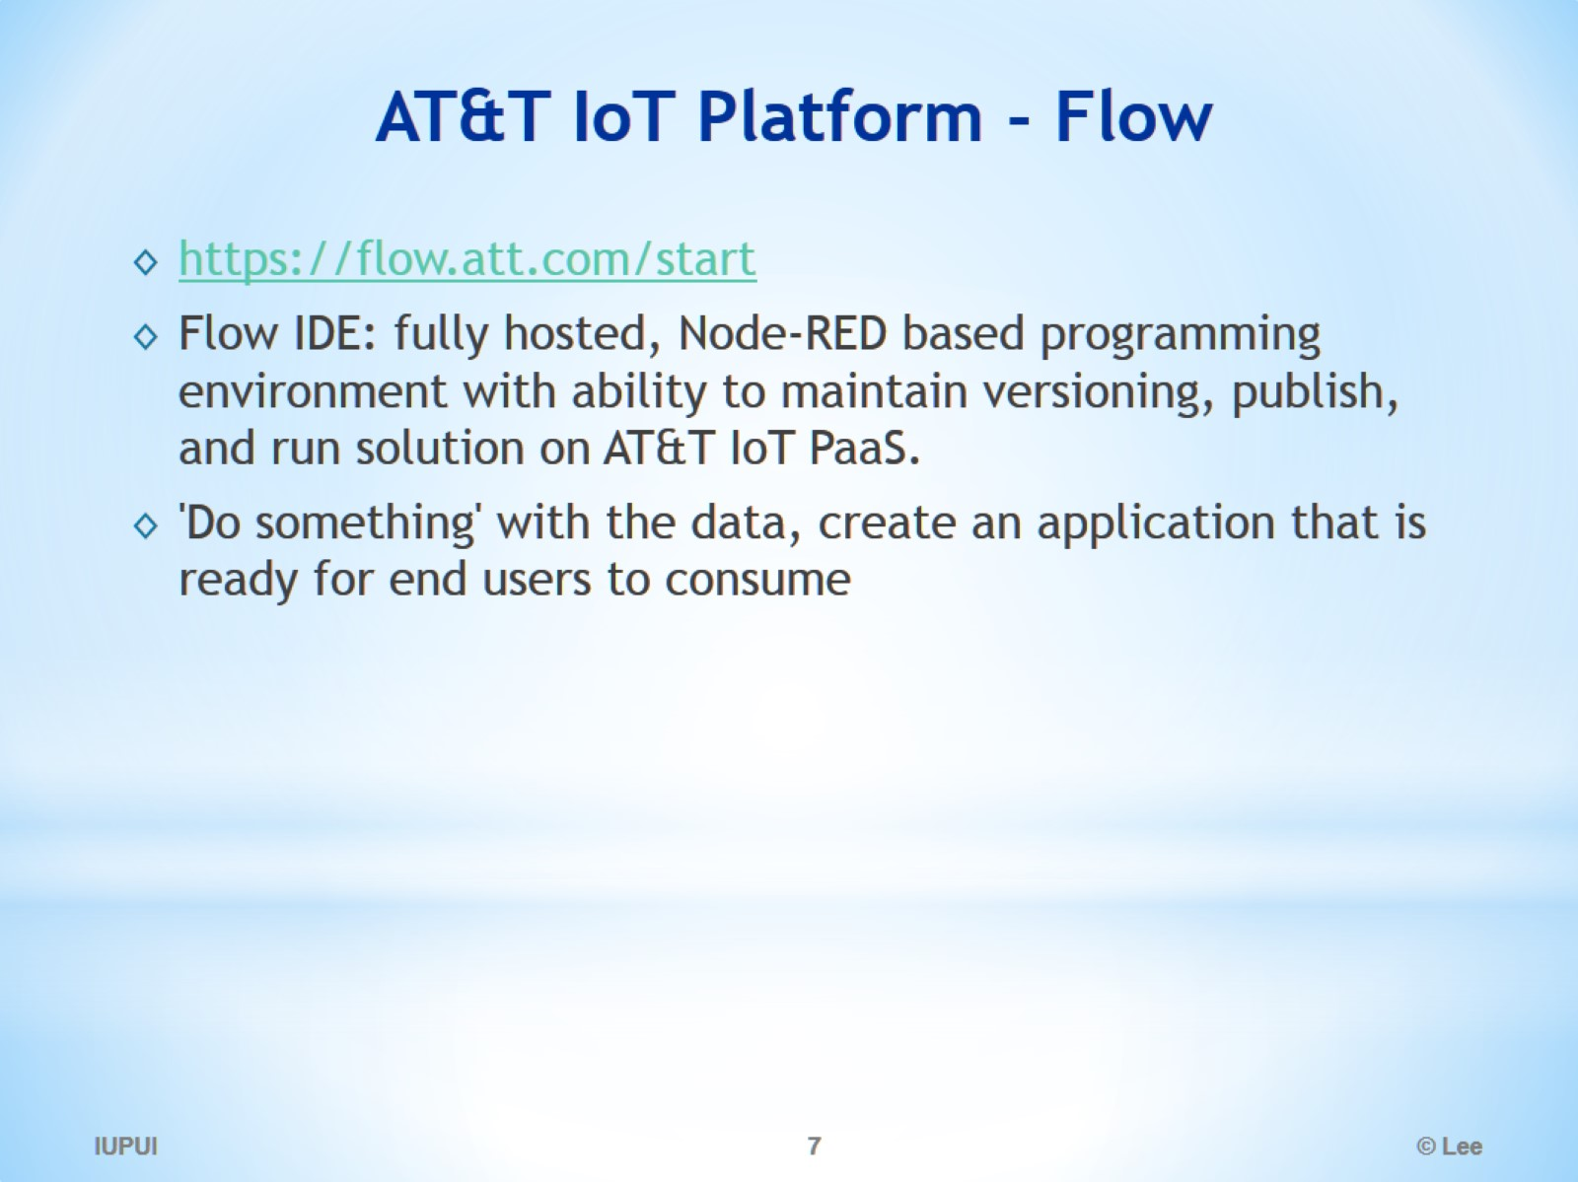
AT&T IoT Platform - Flow

Slide 8
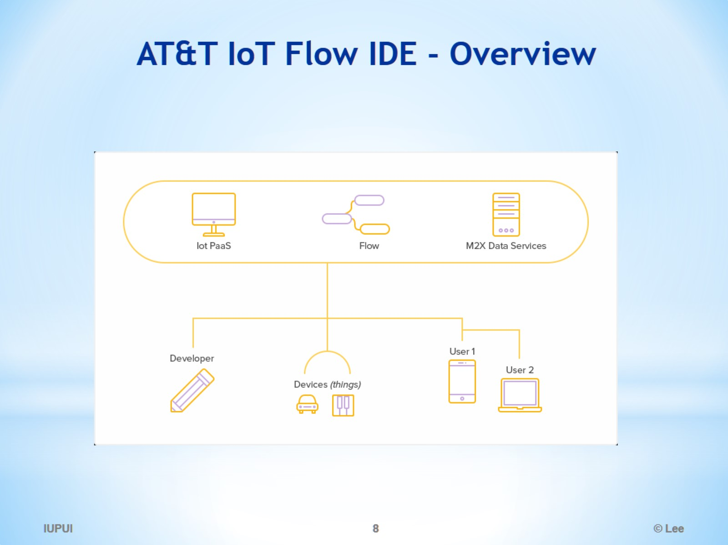
AT&T IoT Flow IDE - Overview

Slide 9
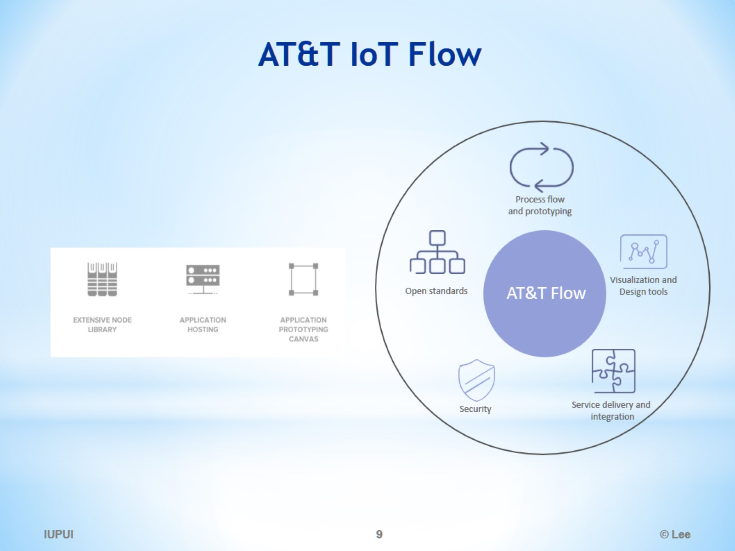
AT&T IoT Flow

Slide 10
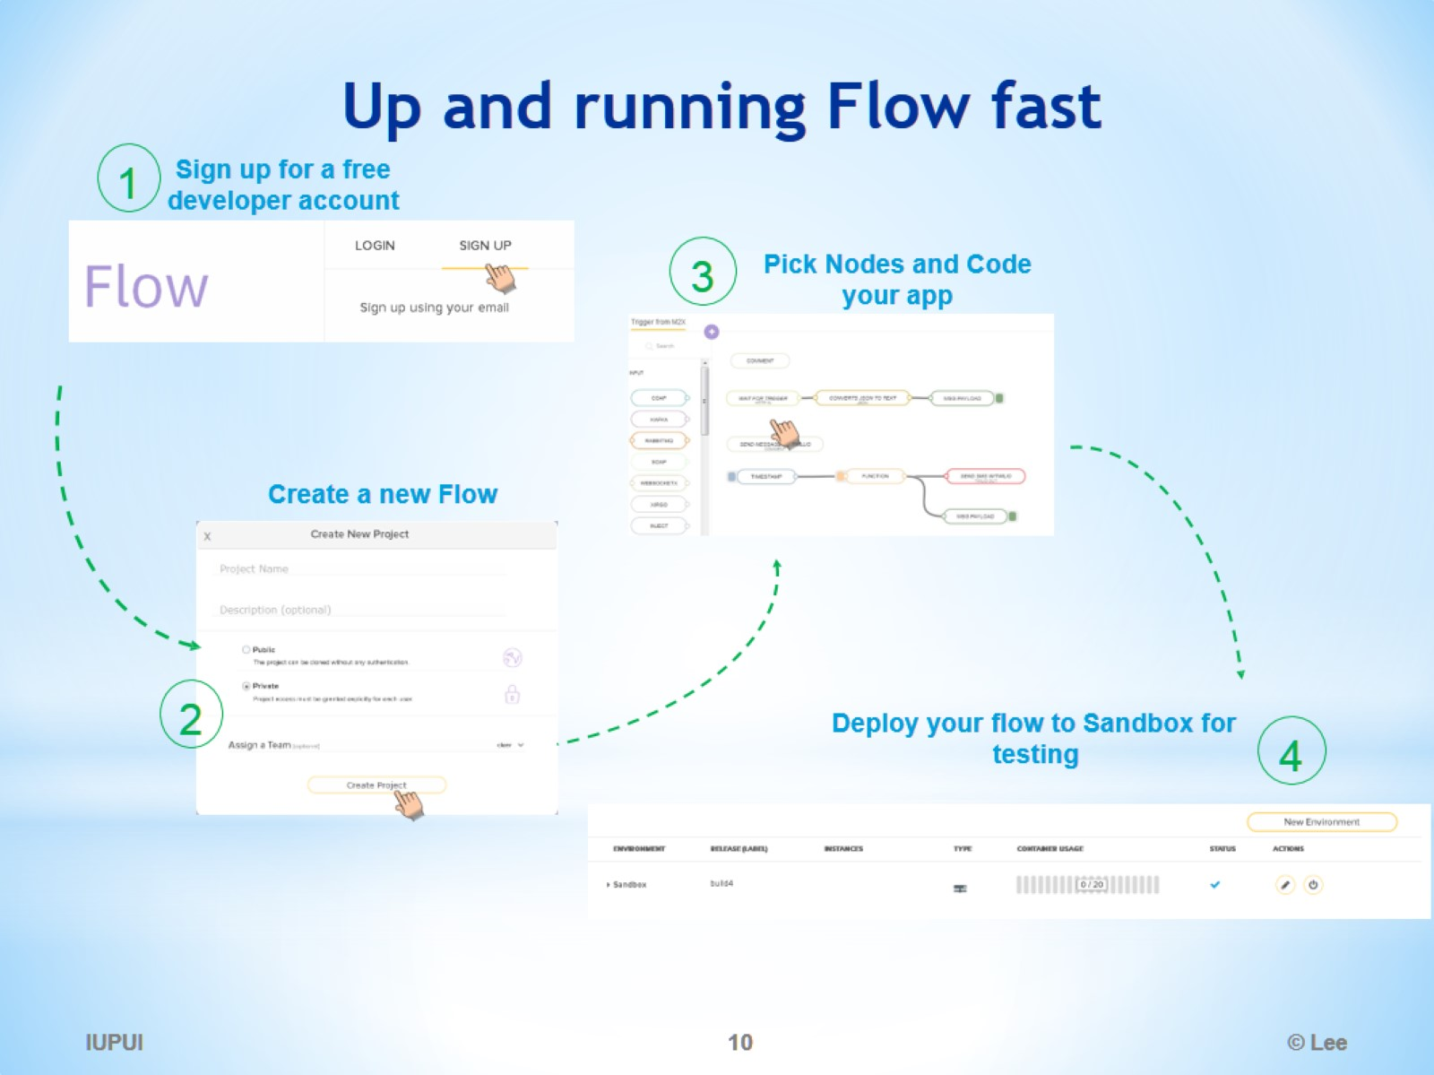
Up and running Flow fast

Slide 11
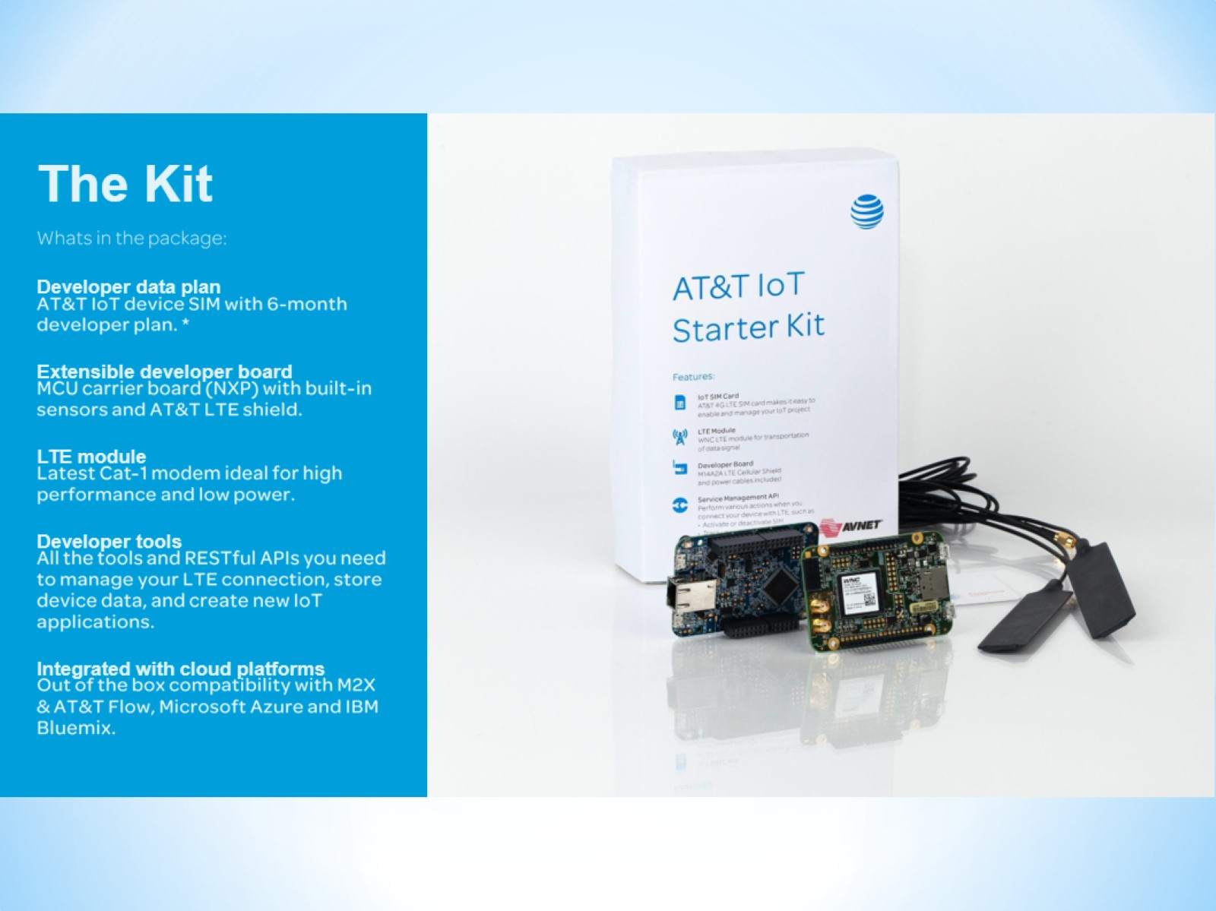

Slide 12
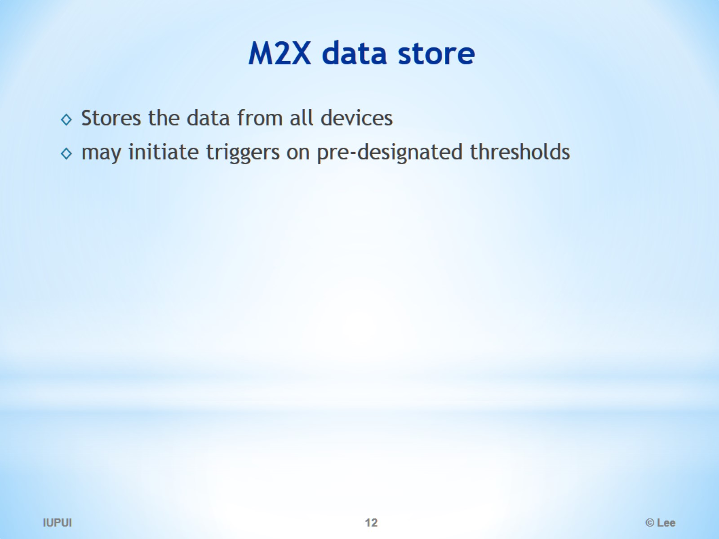
M2X data store

